Slide 1
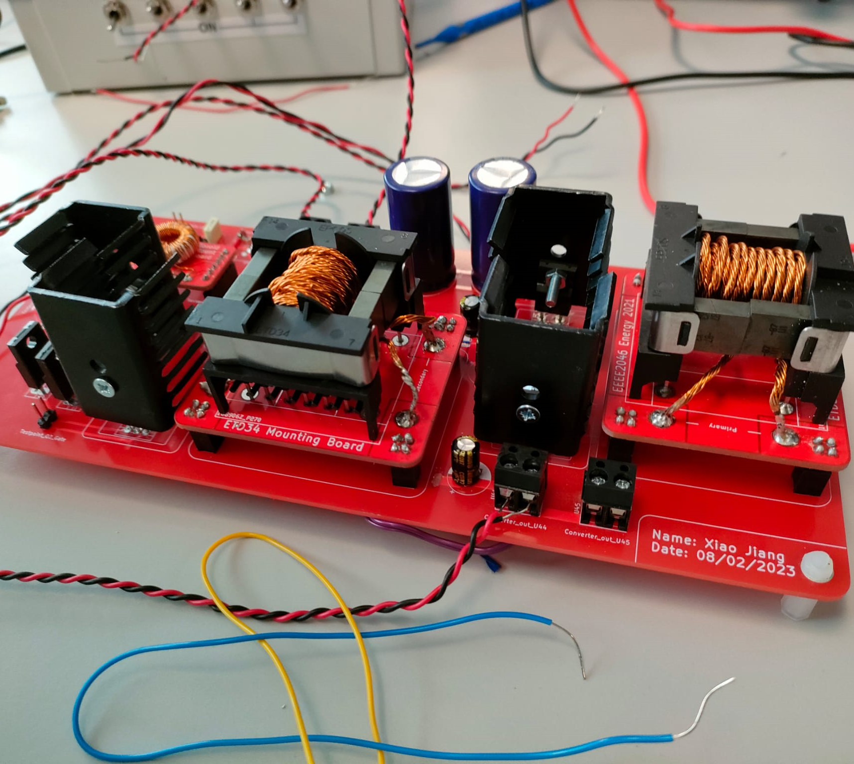
Energy Project
Group: B24
Guan-Sheng Chen (20314386)

Slide 2
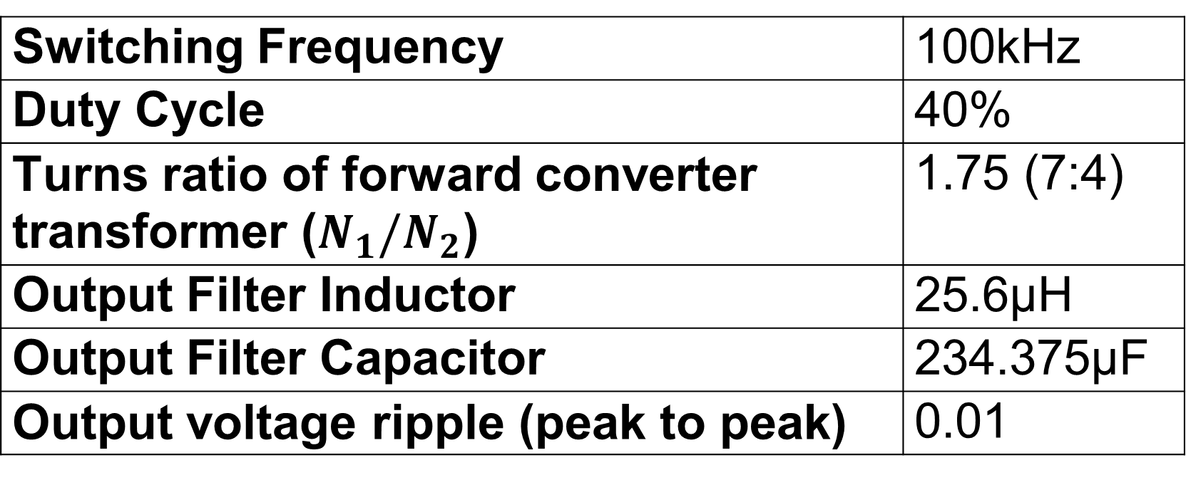
Open Loop Converter (Ideal)
Switching Frequency | 100kHz
Duty Cycle | 40%
Turns ratio of forward converter transformer ($N_{1}/N_{2}$) | 1.75 (7:4)
Output Filter Inductor | 25.6µH
Output Filter Capacitor | 234.375µF
Output voltage ripple (peak to peak) | 0.01

Slide 3
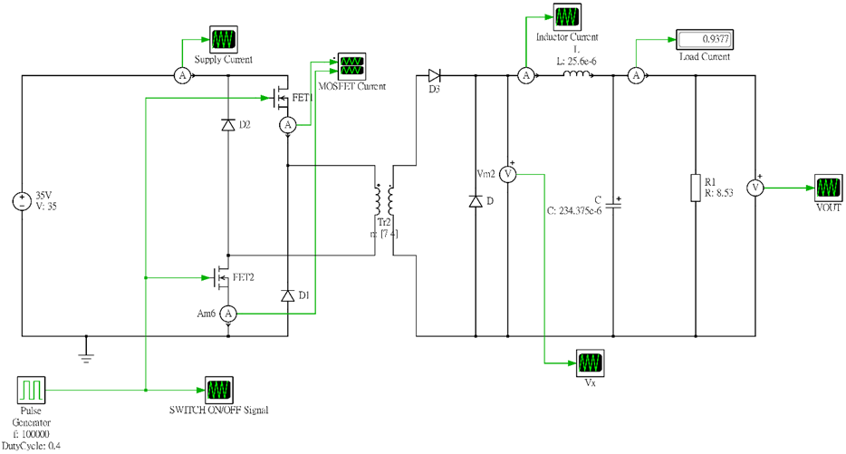
Schematic (Ideal)

Slide 4
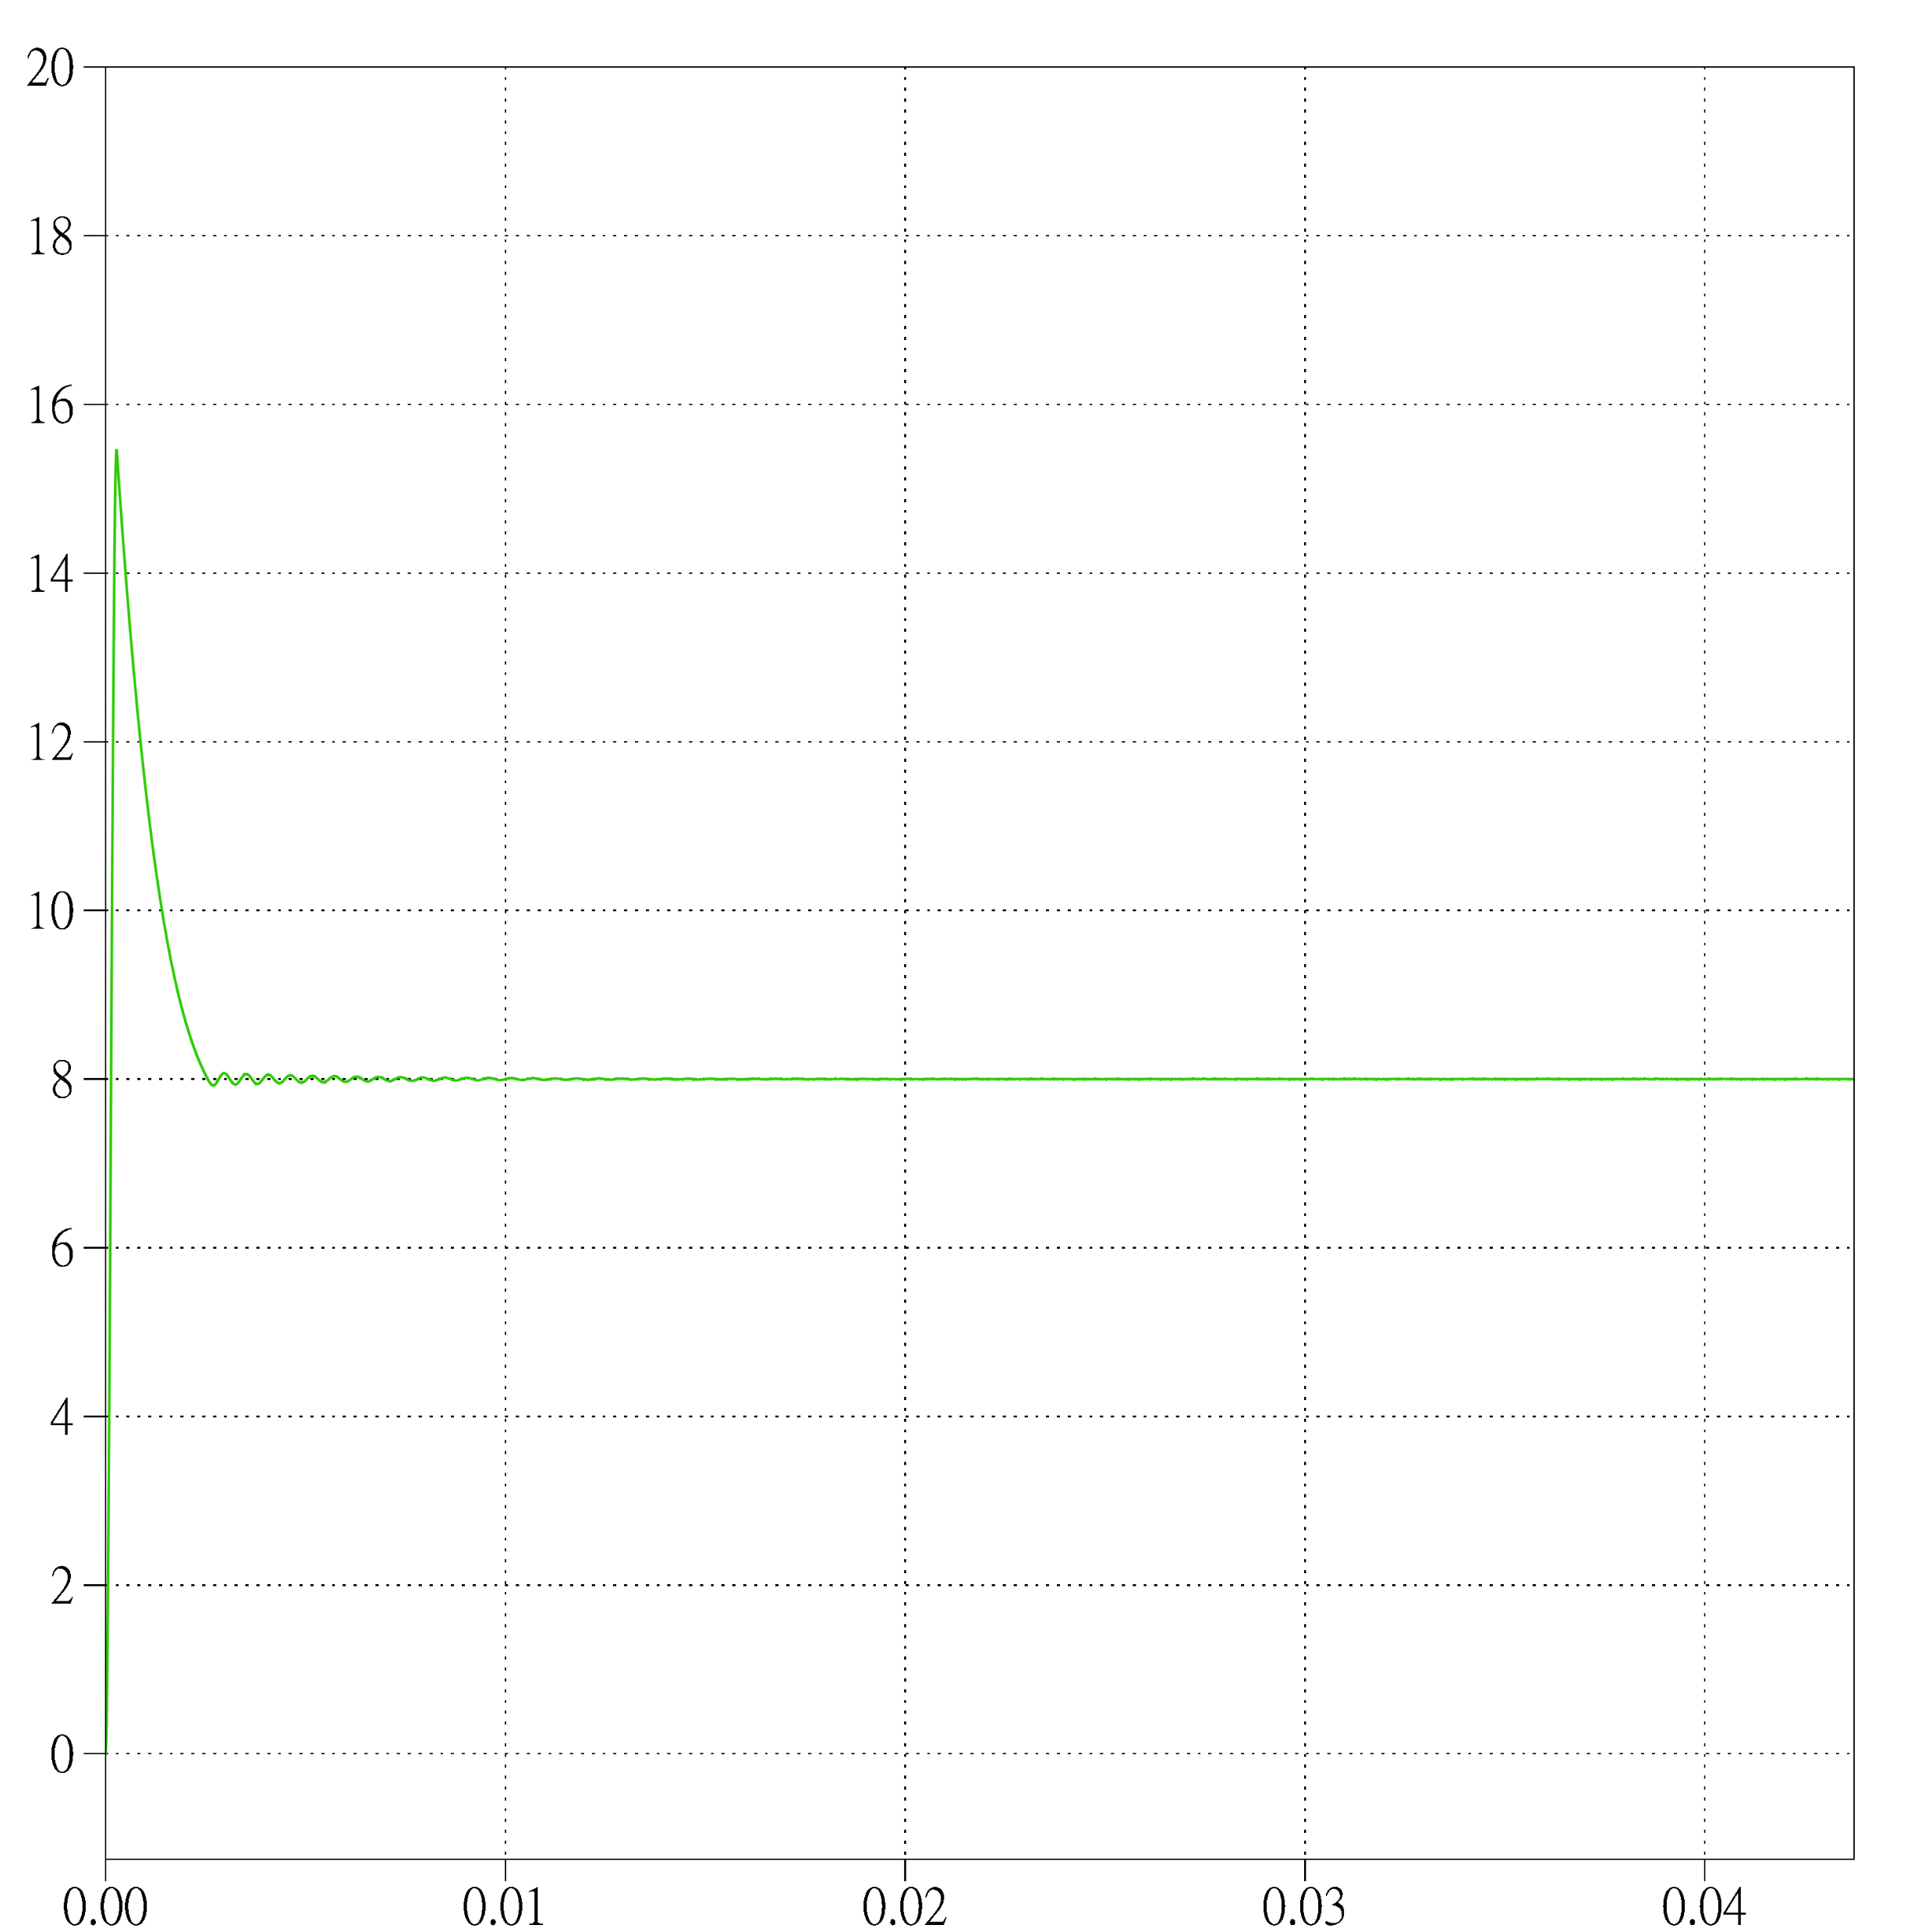
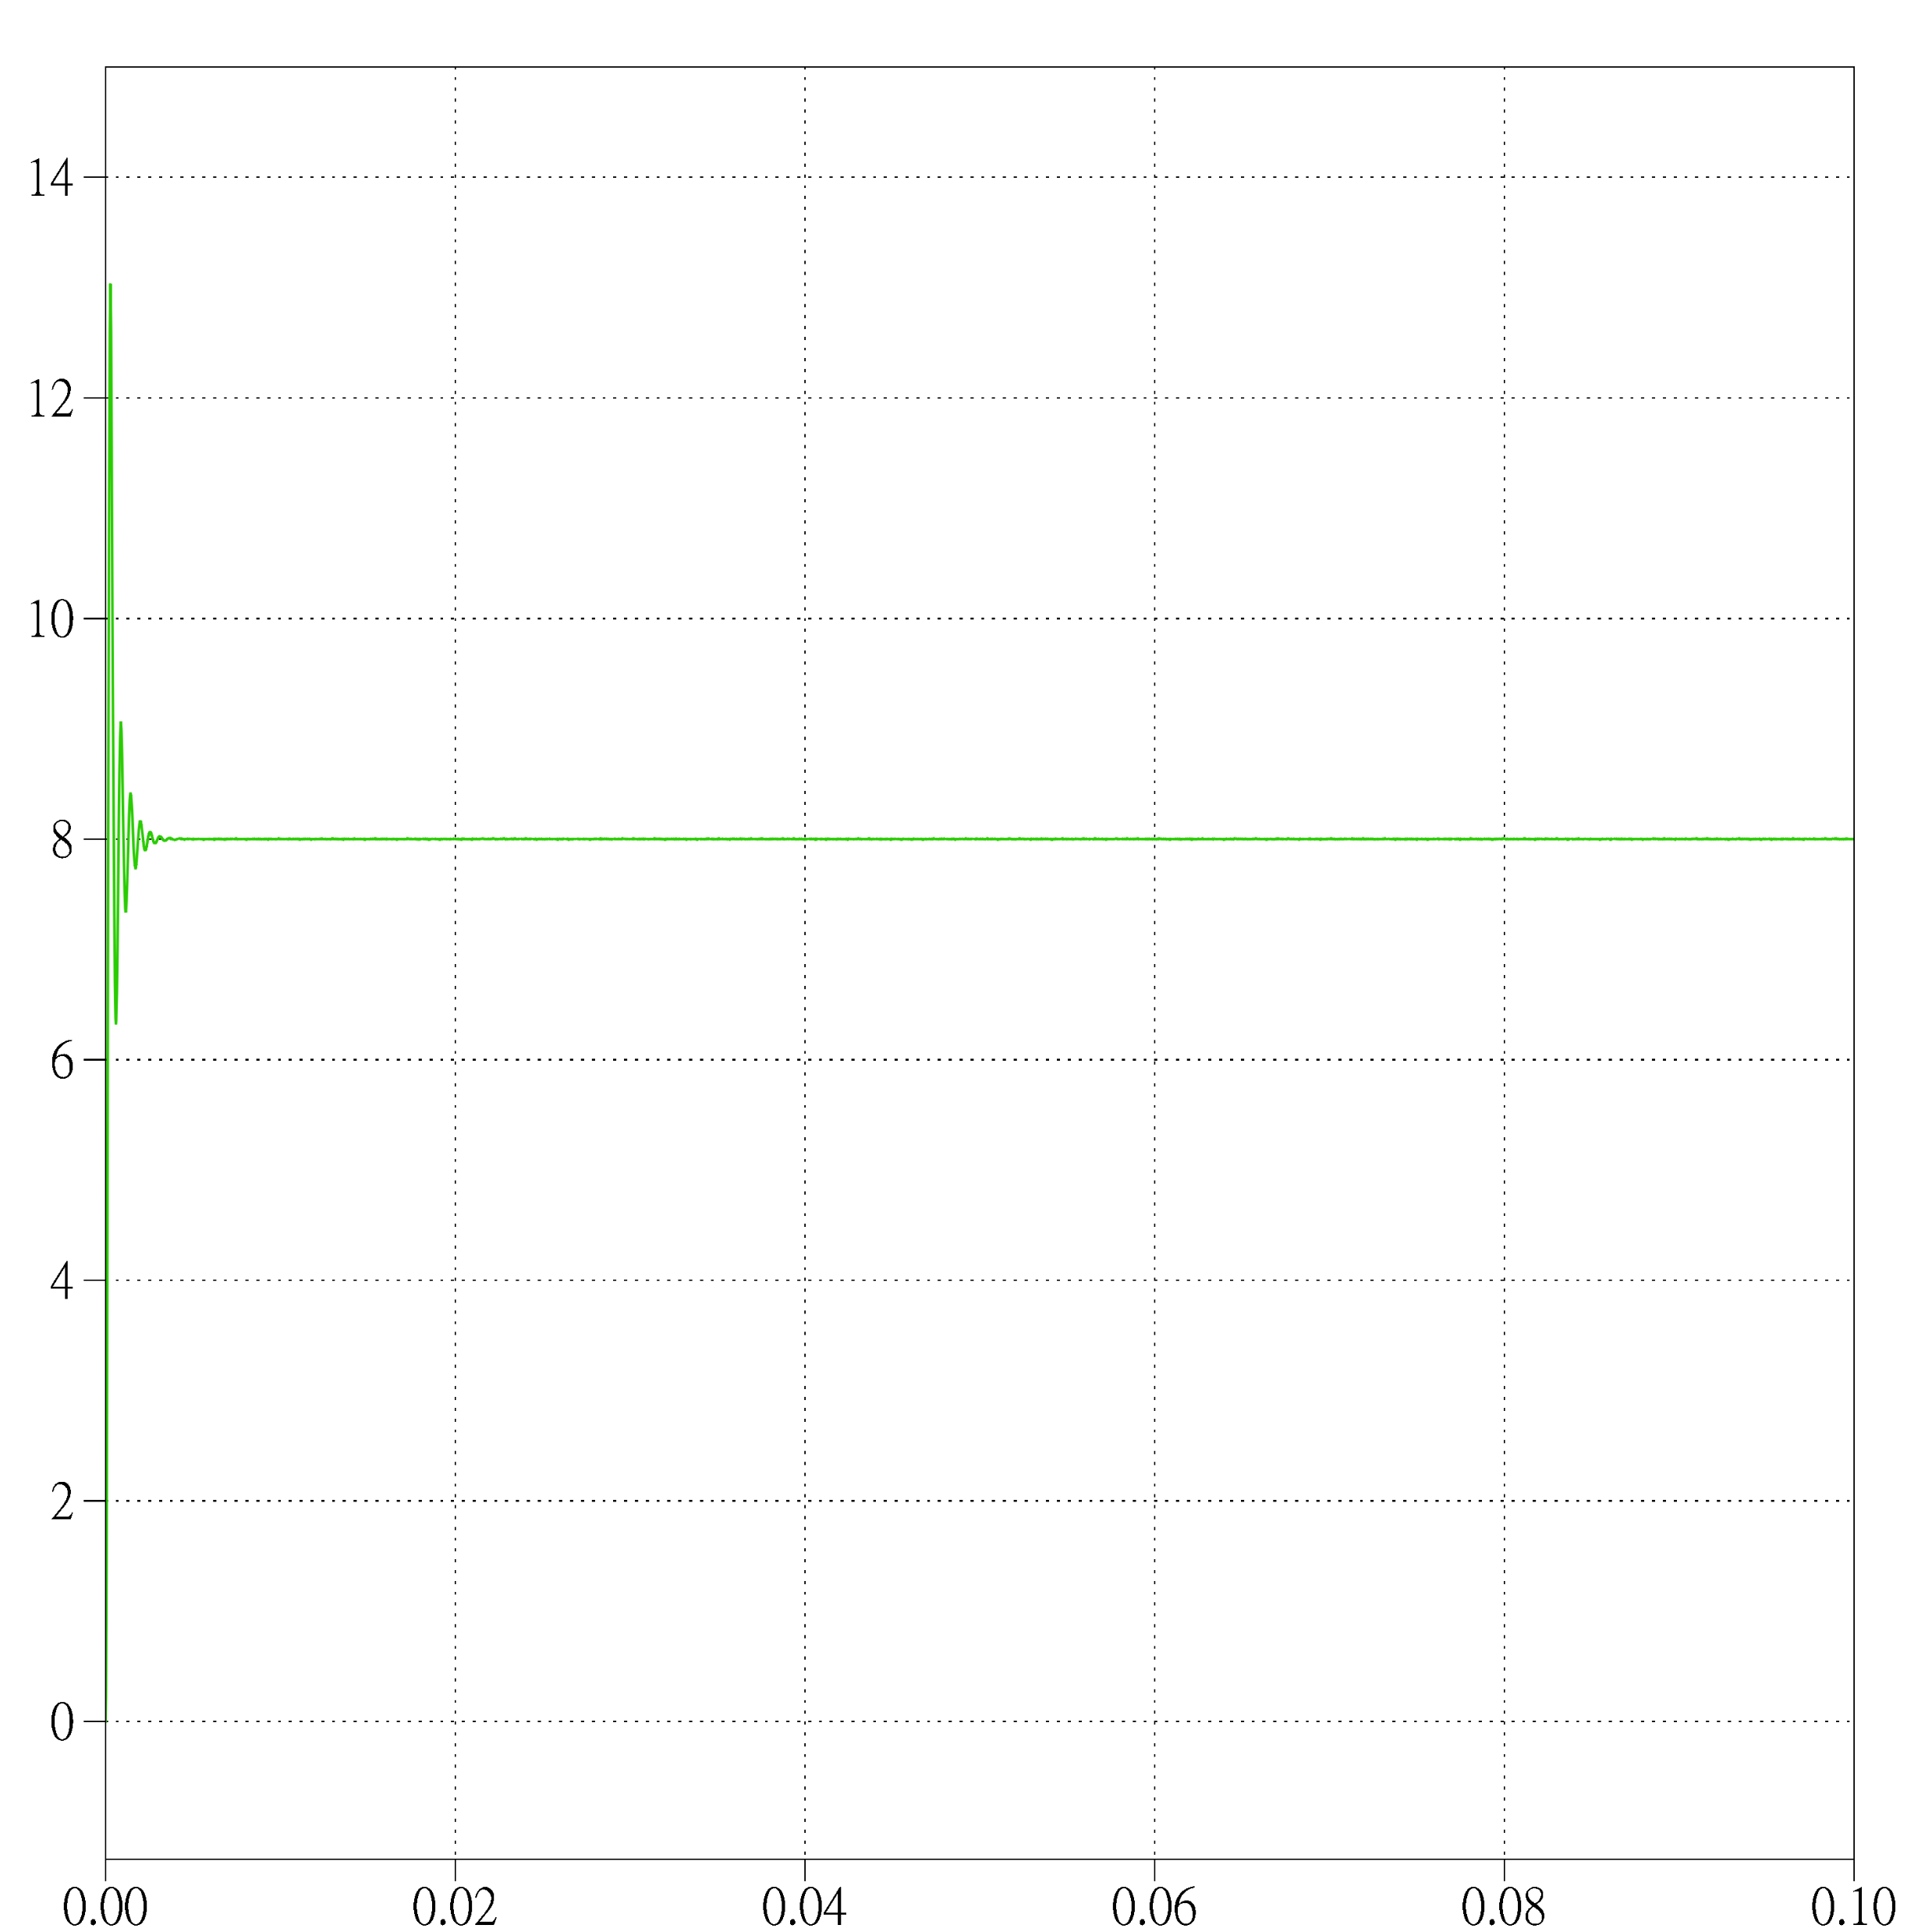
Simulation Result (Vout)
Ideal DC Threshold load Ideal DC Rated load

Slide 5
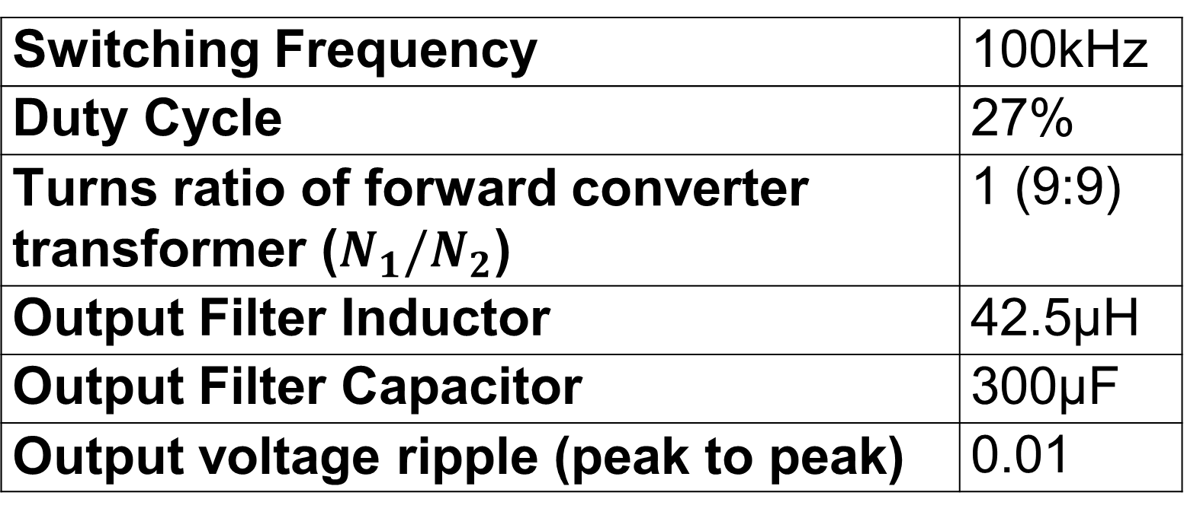
Open Loop Converter (Non-ideal components in AC)
Switching Frequency | 100kHz
Duty Cycle | 27%
Turns ratio of forward converter transformer ($N_{1}/N_{2}$) | 1 (9:9)
Output Filter Inductor | 42.5µH
Output Filter Capacitor | 300µF
Output voltage ripple (peak to peak) | 0.01

Slide 6
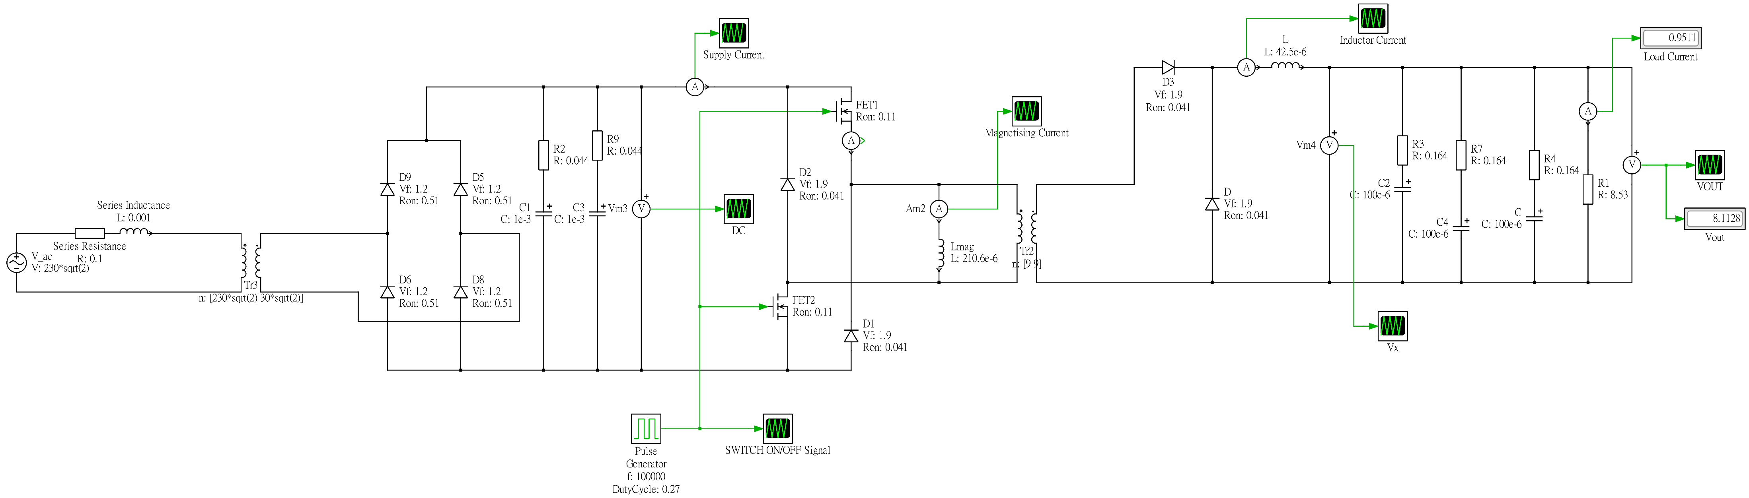
Schematic (Non-ideal components in AC)

Slide 7
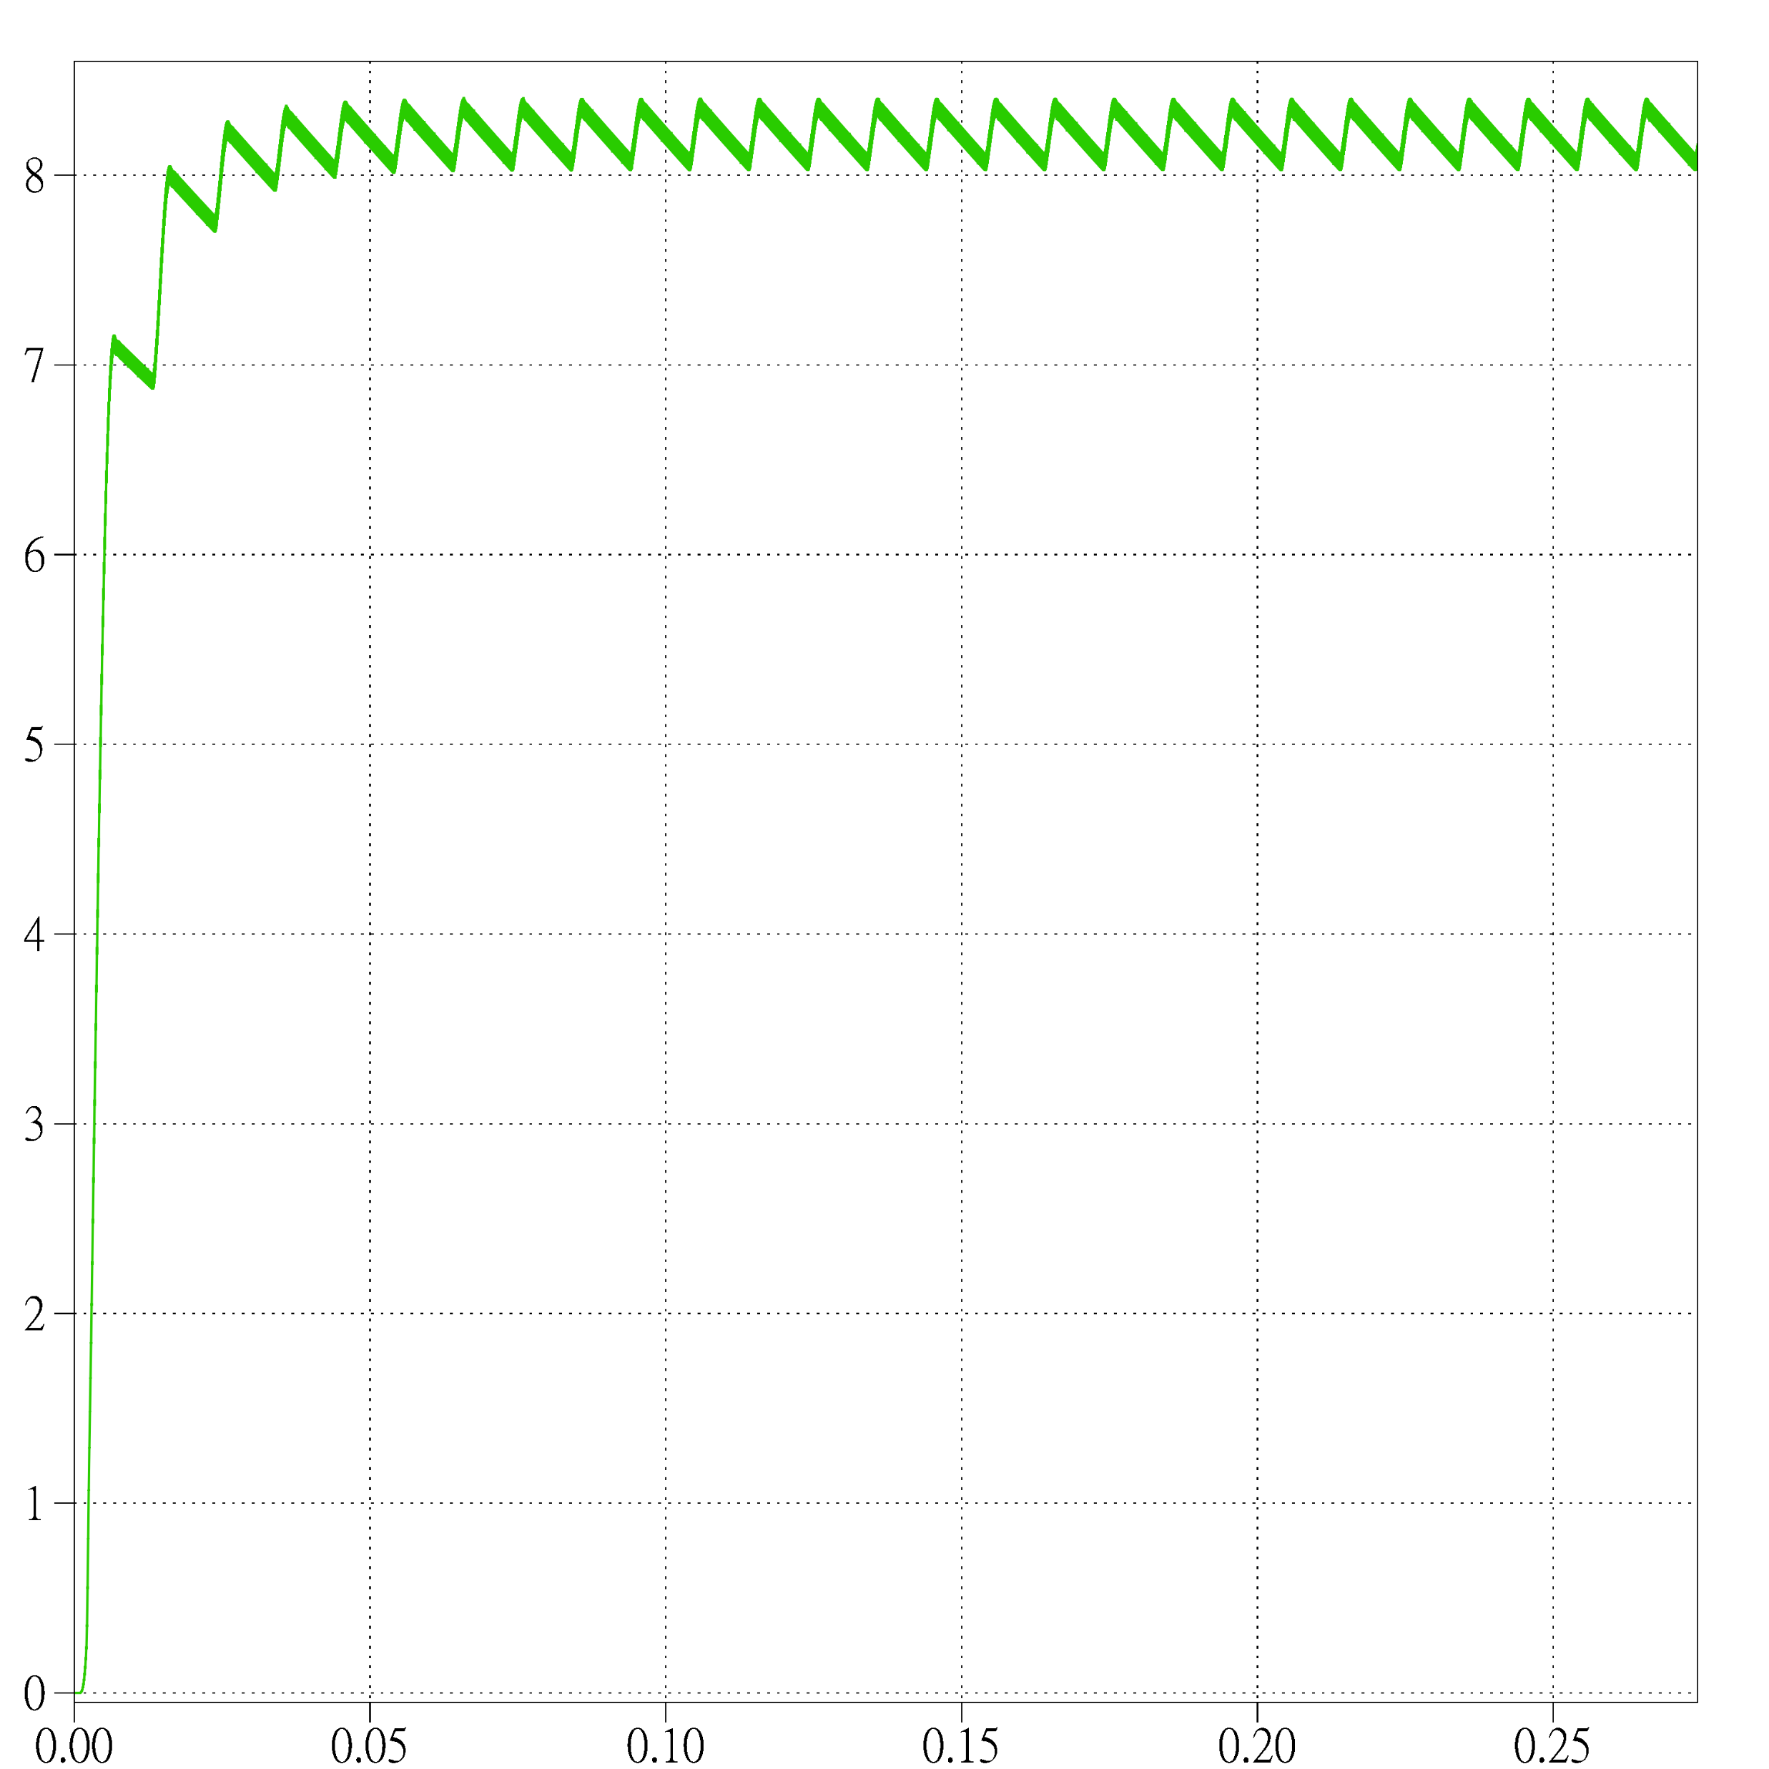
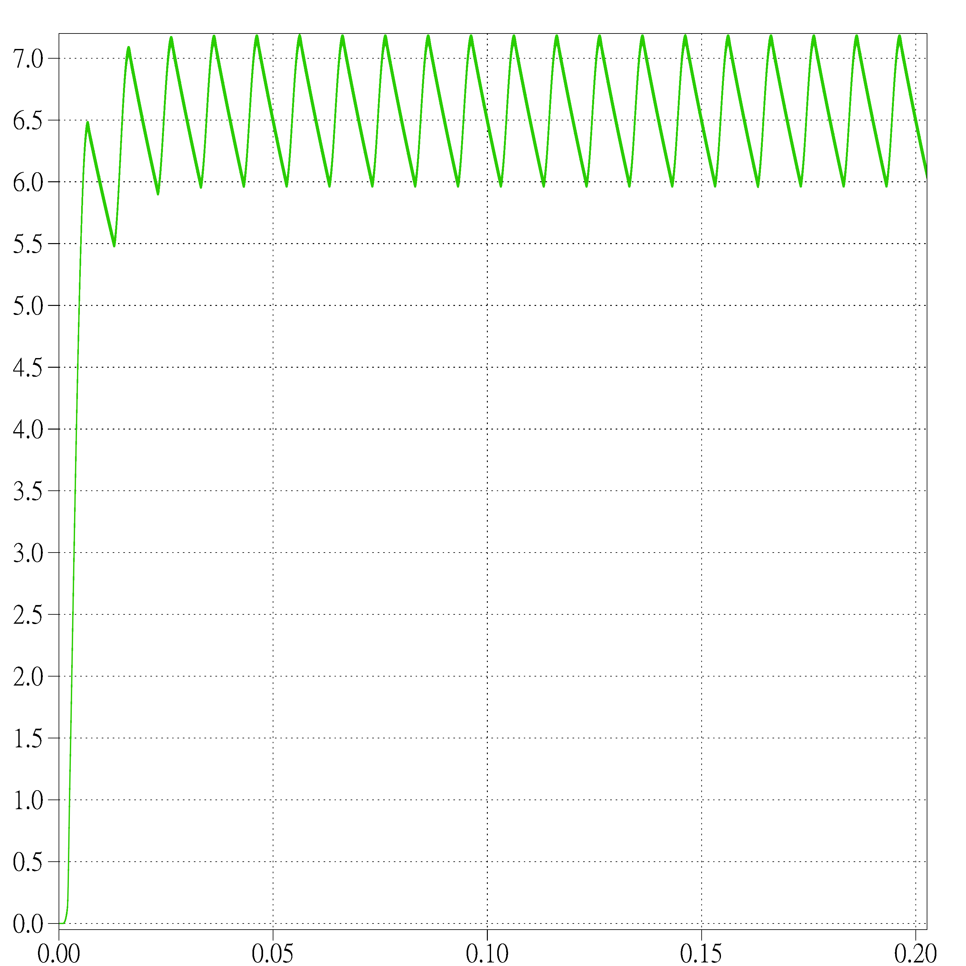
Simulation Result (Vout)
Non-ideal Threshold load Non-ideal Rated load

Slide 8
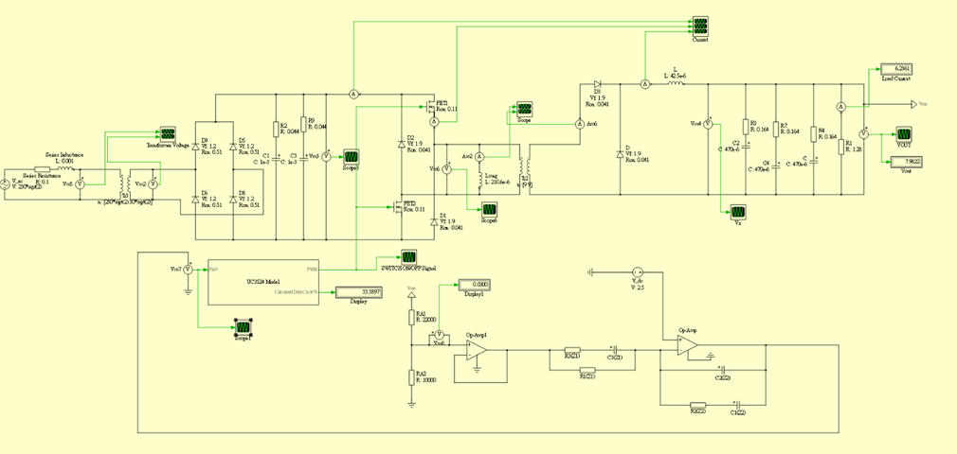
Control and Closed Loop

Slide 9
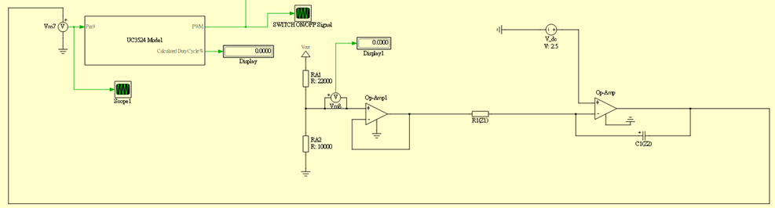
Type 1

Slide 10
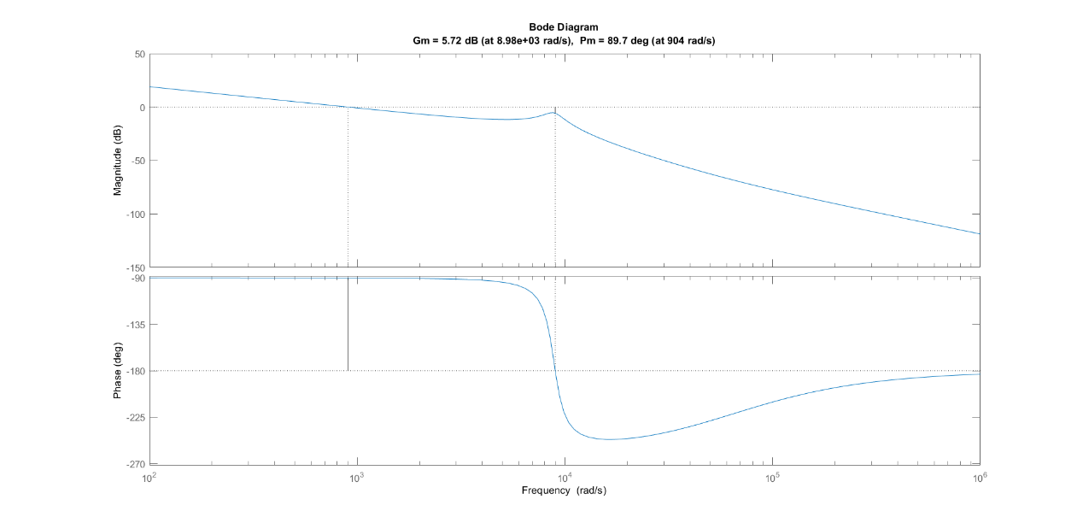
Type 1 Result

Slide 11
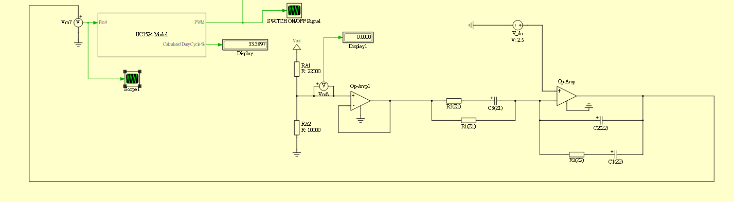
Type 3

Slide 12
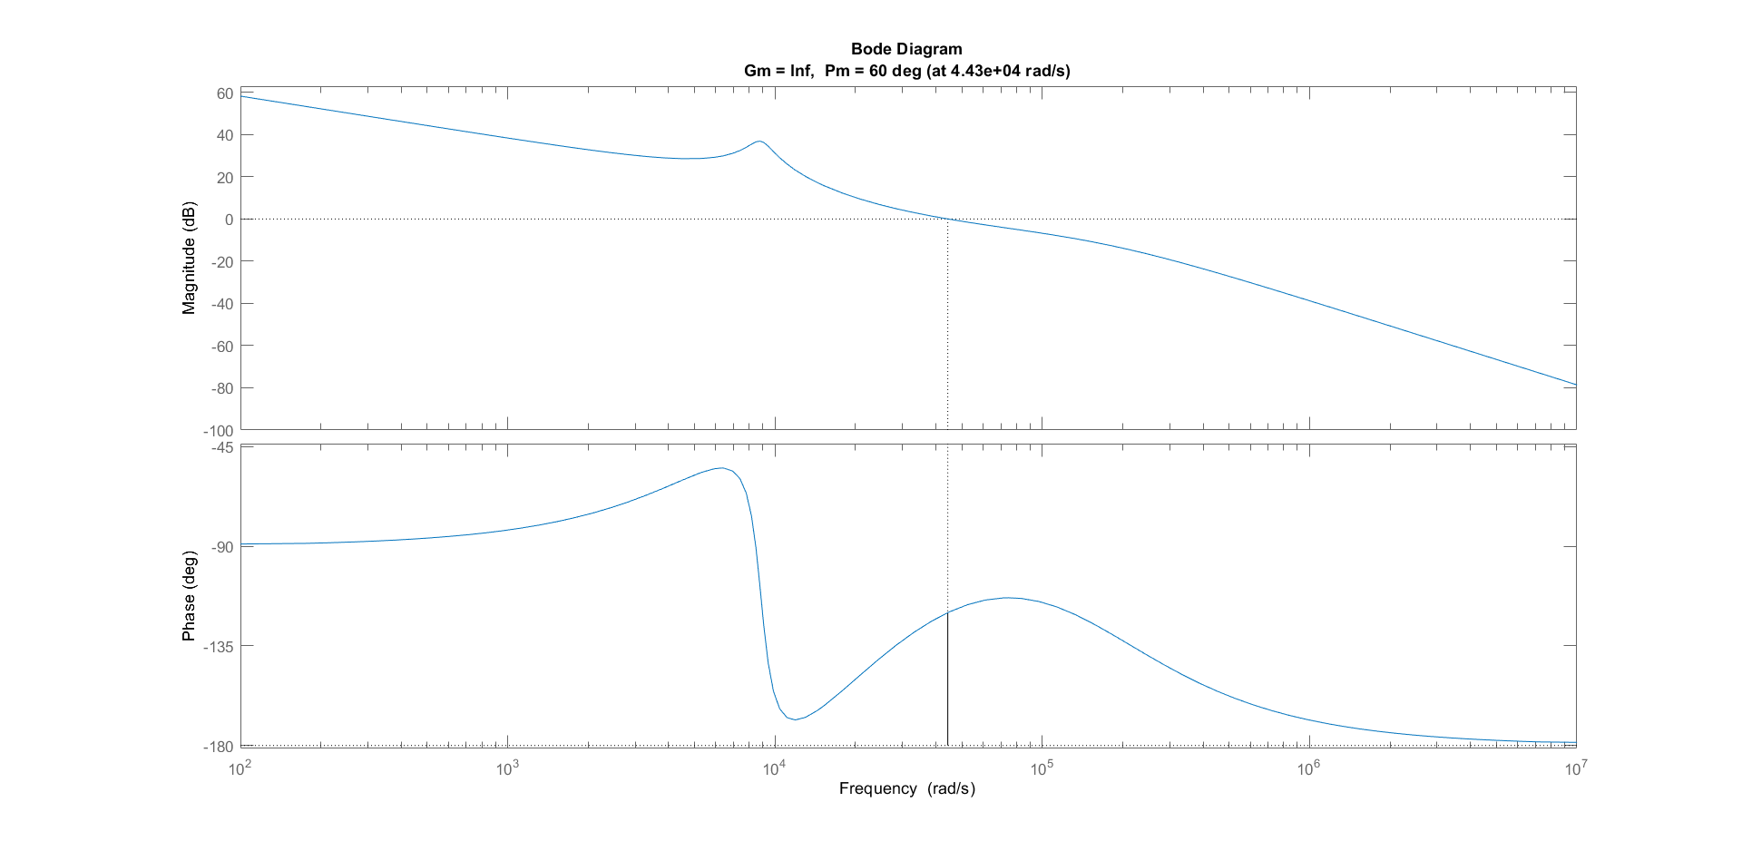
Type 3 Result

Slide 13
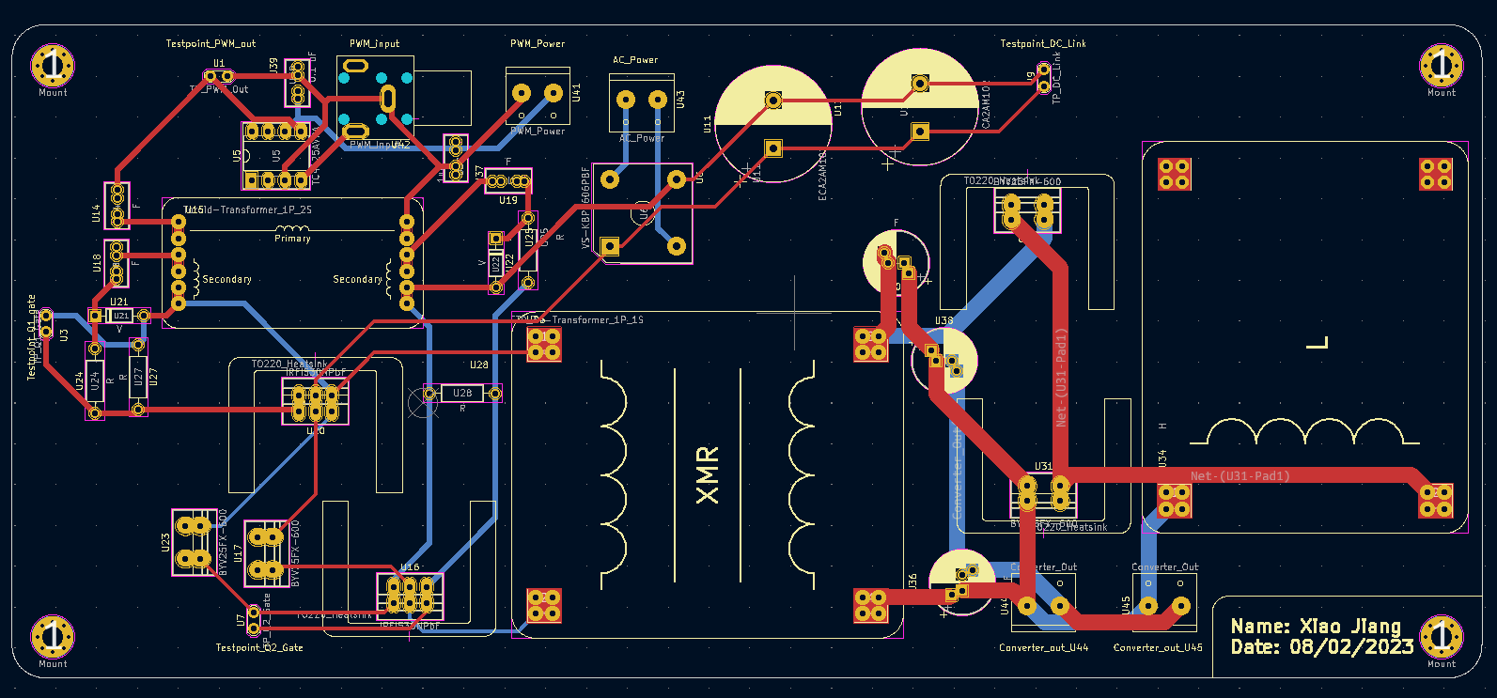
PCB (Original)

Slide 14
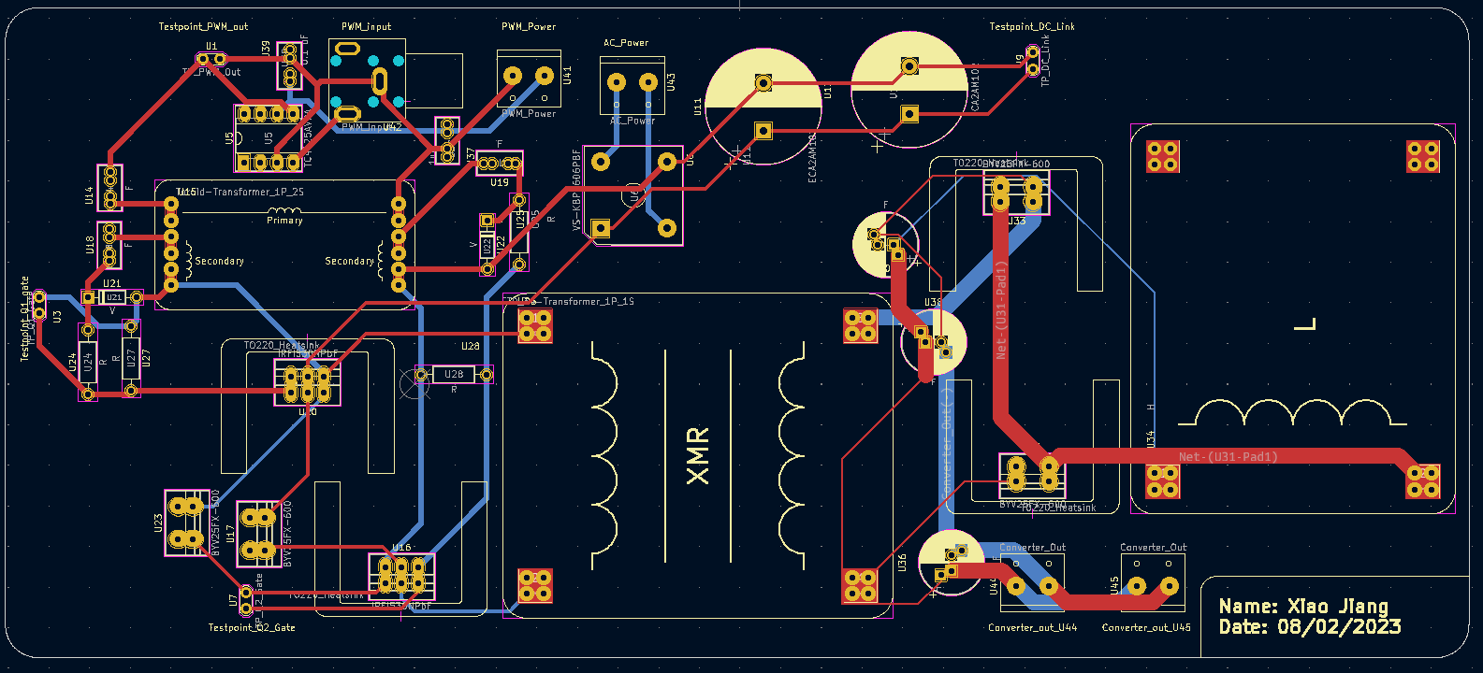
PCB (Modified)

